Slide 1
HOSPITALITY STUDIES GRADE 10
SECTORS AND CAREERS

Slide 2
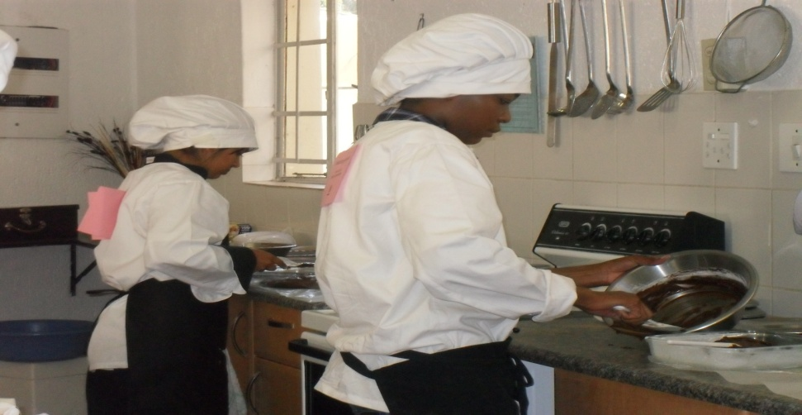
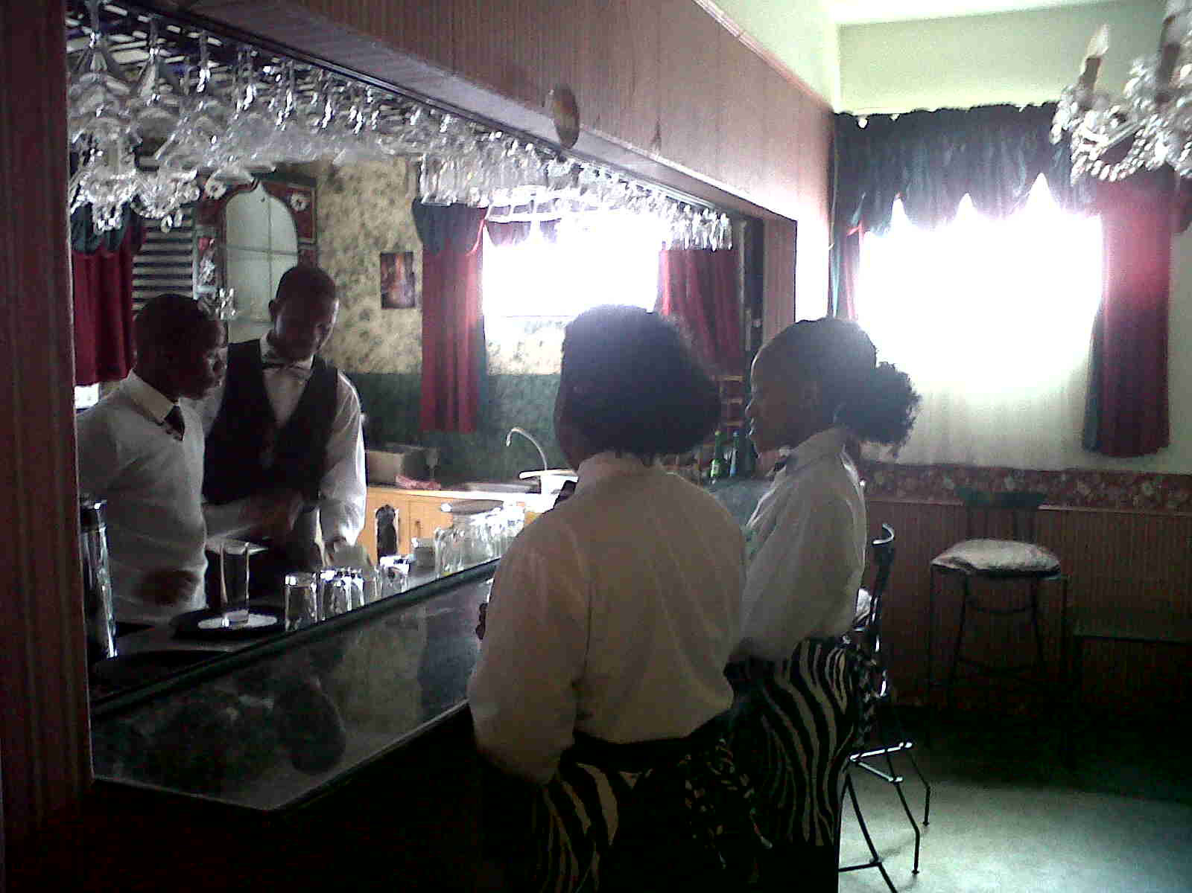
WHAT IS HOSPITALITY STUDIES
Hospitality occurs in homes, public spaces and between countries
Hospitality Studies operates in commercial fields providing Food and Beverage, accommodation and entertainment to guests

Slide 3
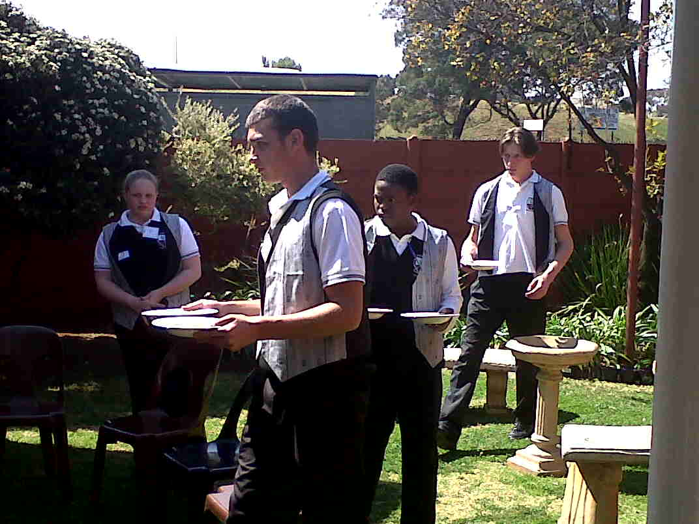
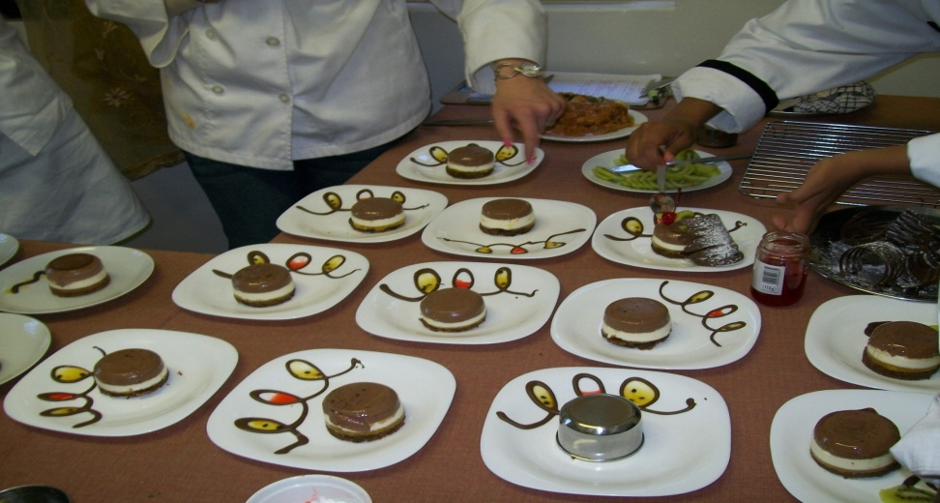
WHAT IS HOSPITALITY STUDIES
It promotes critical awareness of social, cultural, economic and environmental factors affecting hospitality industry
It fosters creative and entrepreneurial skills by developing hospitality skills
It builds a foundation that could lead to professional hospitality careers in food and beverage, catering, accomodation, entertainment, resorts, tourist attractions, casinos & gaming establishments, festivals and events, tourism or pursue tertiary studies in the field

Slide 4
WHAT IS HOSPITALITY STUDIES
Hospitality Studies is the study of the following six topics:
Hospitality Sectors and Careers
Kitchen and Restaurant Operations
Nutrition and Menu Planning
Commodities
Food and Beverage Service
Hygiene, Safety and Security

Slide 5
WHAT IS HOSPITALITY STUDIES
In Hospitality Studies you will learn:
The production and presentation of different meals
Preparation of venues and setting of tables for different functions
Correct service and clearing techniques of food and beverages

